Slide 1
Microservices and DevOps
DevOps and Container Technology
TestContainers Exercise
Henrik Bærbak Christensen

Slide 2
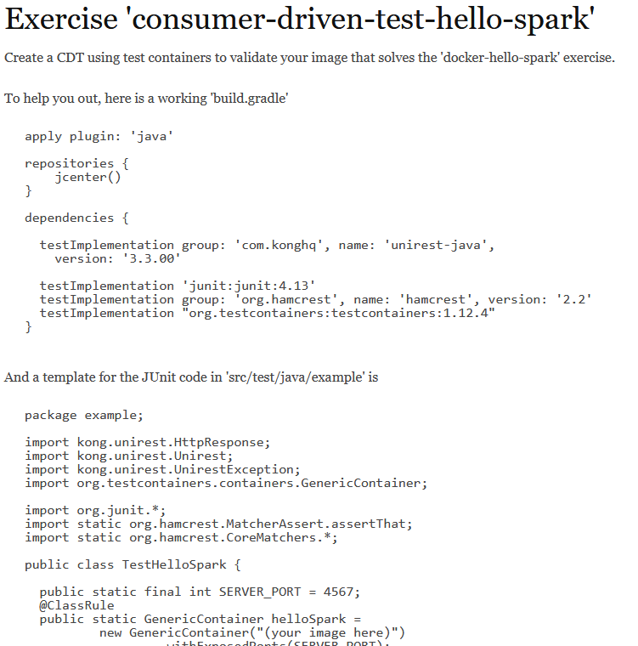
Exercise 1
Create a CDT for your ‘hello spark’ web server using test containers
See ‘consumer-driven-test-hello-spark’ on Mandatory iteration 3
Notes:
META: programmingkata/msdo-testcontainer-exercise-1

Slide 3
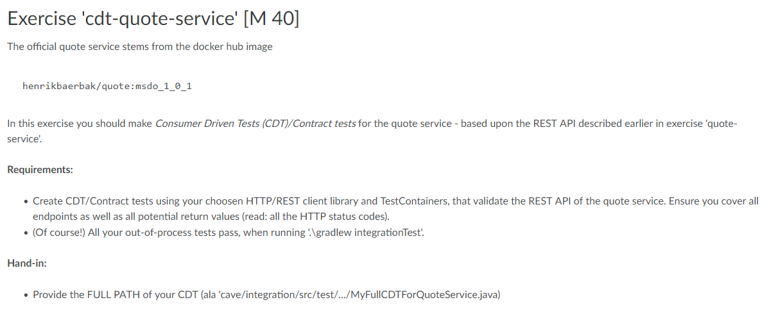
Exercise 2
Solve the mandatory exercises
‘cdt-quote-service’
‘integration-test-quote-service’

Slide 4
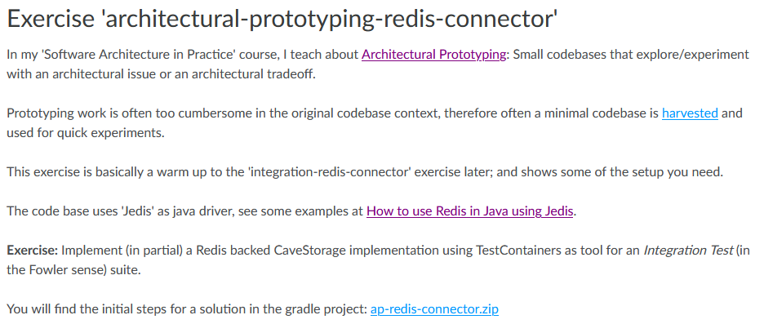
Exercise 3
Begin building an Architectural Prototype that explores implementing the CaveStorage interface using the NoSQL database ‘Redis’.
Hum hum, actually we will talk Redis later today…
Find a zip with starter code on mandatory iteration 3.

